Slide 1
Strategic Leadership
607MAN 303MAN
Leadership Styles & Ethical Leadership
Week 2 S8

Slide 2


What we’re going to cover today…
Traits of Leaders
(2) Leadership Styles
(3) Ethical Leadership

Slide 3
Session Learning Outcomes
Evaluate and apply conceptual and practical approaches to strategic leadership in a range of different organisational settings.
Analyse contemporary research on the role of leadership in managing change.
Critically assess the relevance of leadership styles to key sector changes including globalisation, internationalisation, strategy, technological innovation and organisation development.
Identify and critically reflect on leadership capabilities, styles and strategies of key Business leaders across a range of sectors.
Evaluate an incident of strategic organisational change by exploring the role of leadership and the measurement and management of Key Performance Indicators (KPI’s).
Critically explore the ethical relationships between leaders and followers in relation to decision making, corporate governance and policy practices in organisations.

Slide 4
Leadership Traits
Drive to achieve
Motivation to lead
Honesty and integrity
Self-confidence
Ability to withstand setbacks
(Kilpatrick and Locke 1991)

Slide 5
Leadership Traits
Standing firm
Emotionally resilient
Cognitive ability
Knowledge of the business
(Kilpatrick and Locke 1991)

Slide 6
Traits of Charismatic Leaders
Dominant
Strong desire to influence
Self-confident
Strong sense of moral values (House 1976)

Slide 7

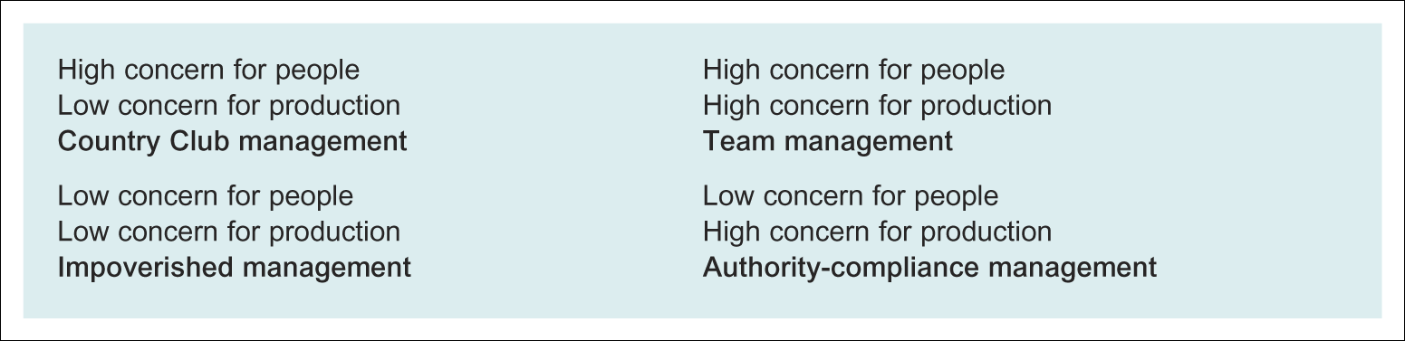
Blake and Mouton’s Four Leadership Styles
(Blake & Mouton 1964, cited in Torrington et al. 2014: 218)

Slide 8
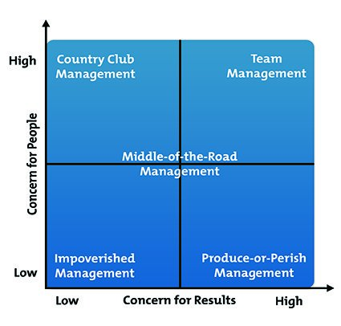

Slide 9
Leadership Styles for Different Situations
Contingency models address the importance of context
Complex
Appropriate leadership style can be dependent on diagnosis of readiness of followers – situational leadership

Slide 10
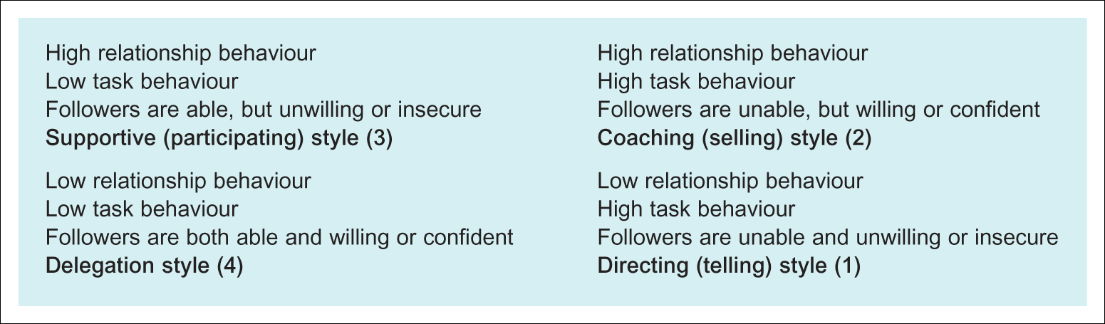
Hersey and Blanchard’s Four styles of Leadership
(Hersey & Blanchard 1988: 169, cited in Torrington)

Slide 11
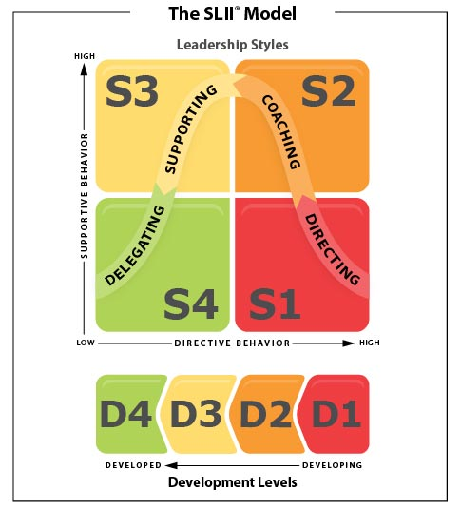

Slide 12
Other Contingency Models
Fiedler – leadership behaviour is matched to
Nature of relationship between leader and members
Extent to which tasks are highly structured
Position power of leader
Goleman – leadership styles
Coercive, authoritative, affiliative, democratic, pacesetting, coaching
Use of more than one style is effective

Slide 13
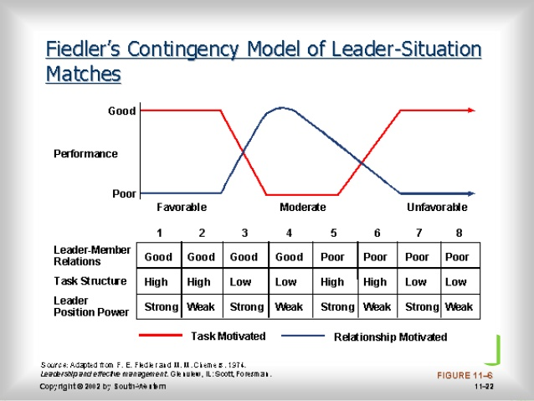

Slide 14
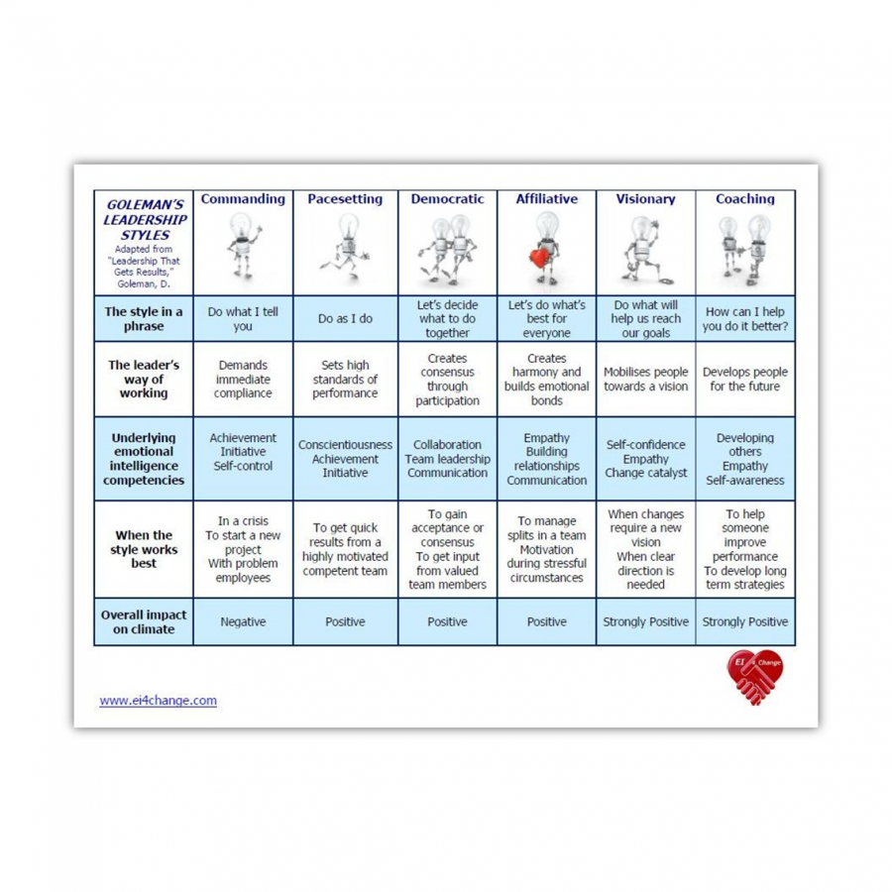

Slide 15
Transformational Leadership
Focus on leader’s role at strategic levels
Shows elements of the trait approach
Use a set of ideal behaviours
Leader usually characterised as hero
Leaders involve followers by generating high commitment
Leaders communicate high expectations and promote self-confidence

Slide 16
Implications for Leadership
Emphasis has moved away from one leader at the top of an organisation
Empowering leaders can facilitate many members of the organisation taking on leadership roles
Feminine leadership styles may be more effective in consensually driven organisations (see evidence links with cultural nuances cited in GLOBE reports) – Global Leadership and Organisational Behaviour Effectiveness
Notes:
Important to include a global context given the diversity of the students and the likelihood of international demands in future roles

Slide 17
Ethical Leadership

Slide 18
Definition of leadership and ethical leadership
Components of leadership:
Leadership is a process
Leadership involves influence
Leadership occurs in groups
Leadership involves common goals
Ethical leadership:
“setting and pursuing ethical goals and influencing others in an ethical manner”
“influencing the activities of a group toward goal achievement in a socially responsible way”

Slide 19
The importance of ethical leadership
The ‘interpersonal trust’ model developed by Schindler and Thomas (1993)
The importance of each of five underlying interpersonal trust components (competence, consistency, integrity, loyalty, and openness) as they affect trust among supervisors, subordinates, and peers was examined.
The ‘social power’ model developed by French and Raven (refer to last week’s slides)

Slide 20
Daft’s (2008) ten activities of a moral leader
Develop, articulate, and uphold high moral principles.
Focus on what is right for the organization as well as all the people involved.
Set the example you want others to live by.
Be honest with yourself and others.
Drive out fear and eliminate issues that cannot be discussed.
Establish and communicate ethics policies.
Develop a backbone - show zero tolerance for ethical violations.
Reward ethical conduct.
Treat everyone with fairness, dignity, and respect, from the lowest to the highest level of the organization.
Do the right thing in both your private and professional life - even if no one is looking
(Refer to Daft’s The Leadership Experience)

Slide 21
Northouse’s (2013) five principles of ethical leadership
Ethical Leaders Respect Others
Ethical Leaders Serve Others
Ethical Leaders Are Just
Ethical Leaders Are Honest
Ethical Leaders Build Community
(Refer to Leadership Theory and Practice)
TRUST

Slide 22
What we’ve covered today…
Traits of Leaders
(2) Leadership Styles
(3) Ethical Leadership

Slide 23

Traffic Light it
Where is your learning at?
Red = I have misunderstood some of the topics. (write down 2 questions that you need help with)
Amber = I have understood most of the topics so far (write down 1 question and 1 key theme you have understood)
Green = I have understood the topics so far (write down 2 key themes from the lesson to show your understanding)

Slide 24

Reading list
Essential Reading
Lynch, R., (2021) Strategic Management. 9th edn. London: Pearson Education
Yukl, G. (2020), Leadership in Organizations: Global Edition. 9th edn. Los Angeles: SAGE
Recommended Reading
Robbins, S.P., De Cenzo, D.A., Coulter, M. (2020) Fundamentals of Management: Management Myths Debunked! Global Edition. 11th edn. Harlow: Pearson
Johnson, G., Whittington R., Scholes K. (2020) Exploring Strategy: Texts and Cases. 12th edn. Harlow: Pearson.

